Slide 1
Distributed Computing Deadlock Detection in Distributed Systems
Dr. Barsha Mitra
CSIS Dept, BITS Pilani, Hyderabad Campus

Slide 2
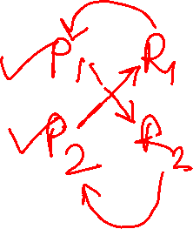
Introduction
a process may request resources in any order
request order may not be known apriori
a process can request a resource while holding others
if the allocation sequence of process resources is not controlled in such environments
deadlocks can occur
deadlock - condition where a set of processes request resources that are held by other processes in the set

Slide 3
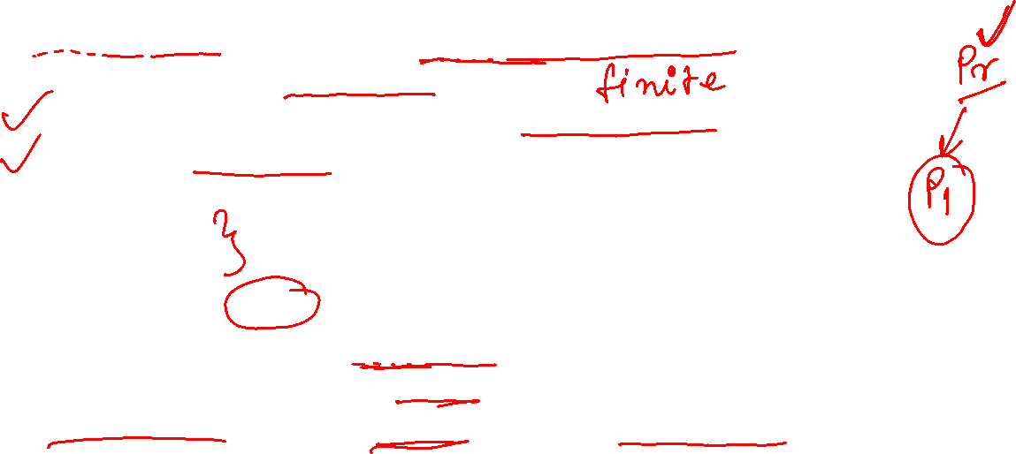
System Model
N processors, N processes, each process runs on a processor
systems have only reusable resources
processes are allowed to make only exclusive access to resources
only one copy/instance of each resource is present
process can be in two states
running
blocked
running state/active state:
process has all the needed resources
either is executing or is ready for execution
blocked state - process is waiting to acquire some resource

Slide 4
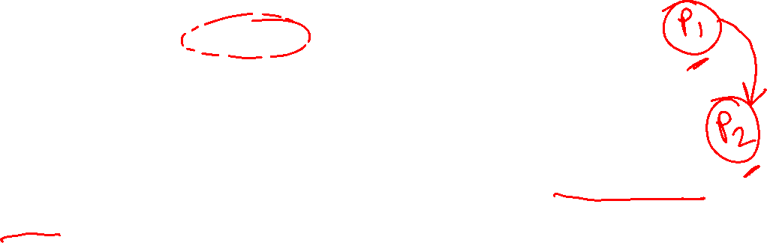
Wait-For Graph (WFG)
state of a distributed system can be modeled as a directed graph
wait-for graph (WFG)
nodes are processes
a directed edge from node P₁ to node P₂ if
P₁ is blocked
P₁ is waiting for P₂ to release some resource
a system is deadlocked if and only if there exists a directed cycle or knot in the WFG

Slide 5
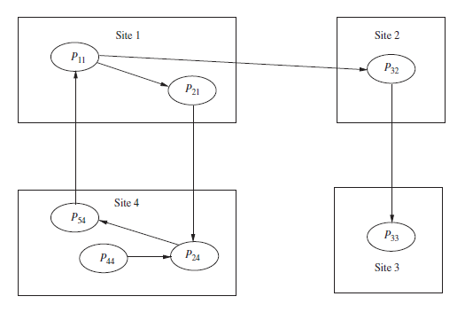

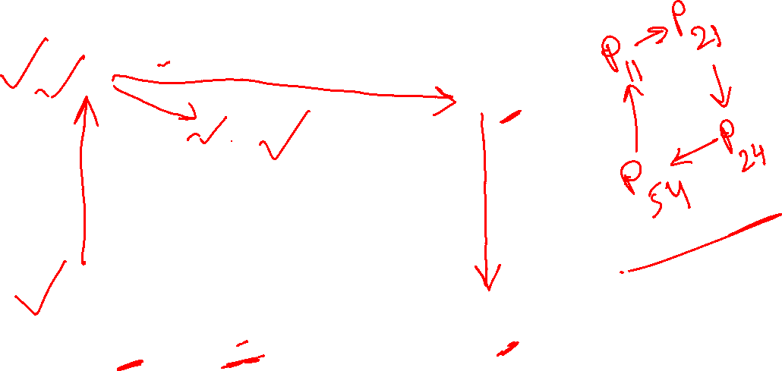
Wait-for graph (WFG)

Slide 6
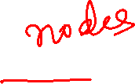
Wait-for graph (WFG)
knot –
collection of vertices and edges such that every vertex in the knot has outgoing edges, and all outgoing edges from vertices in the knot terminate at other vertices in the knot
it is impossible to leave the knot while following any path along its directed edges

Slide 7

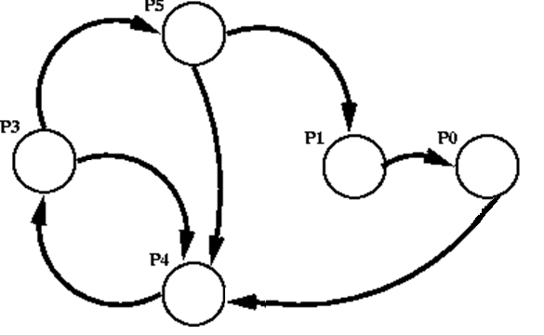
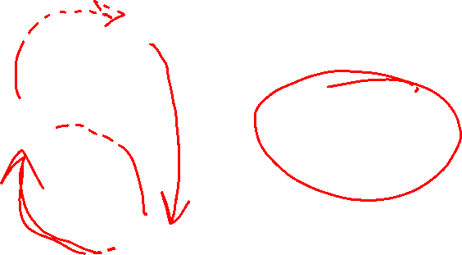
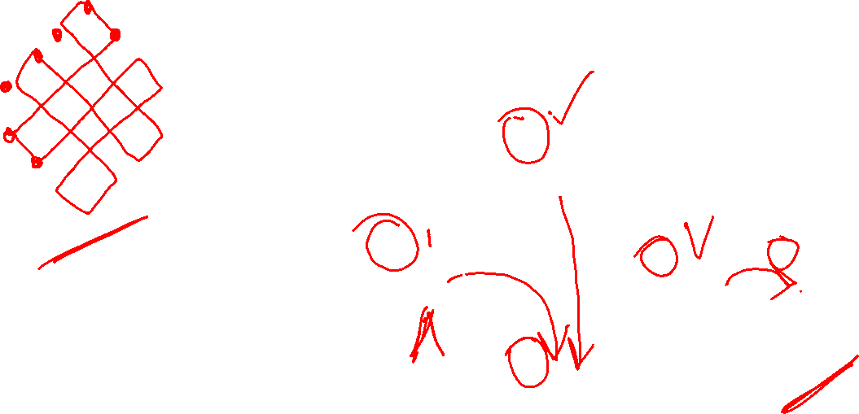
Wait-for graph (WFG)
Image Source: https://www.google.co.in/search?q=cycle+vs+knot&biw=1366&bih=657&source=lnms&tbm=isch&sa=X&ved=0ahUKEwihz9GVwrLPAhVBto8KHZx9D_IQ_AUIBigB#imgrc=7y11eqv7-wrLpM%3A
Image Source: https://www.cs.colostate.edu/~cs551/CourseNotes/Deadlock/WFGs.html

Slide 8
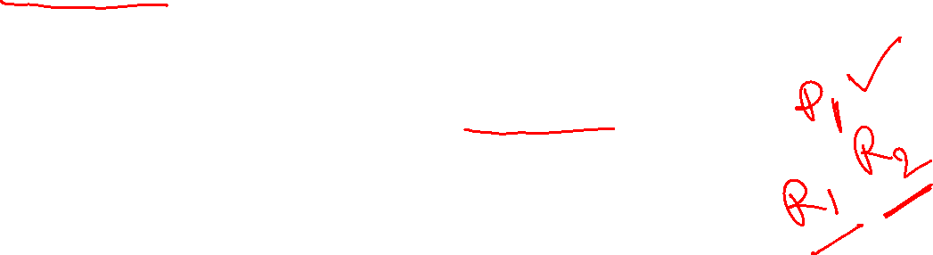
AND Model
a process can request more than one resource simultaneously
request is satisfied only after all the requested resources are granted to the process
requested resources may exist at different locations
out degree of a node in the WFG for AND model can be greater than 1
presence of a cycle in the WFG indicates a deadlock
each node of the WFG is called an AND node

Slide 9

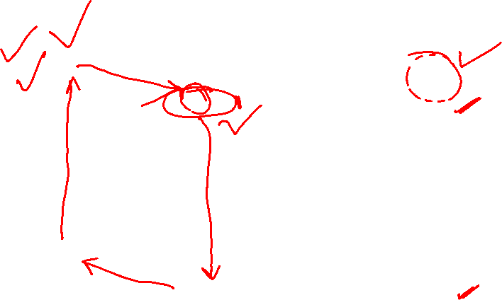
AND Model

Slide 10

AND Model
if a cycle is detected in the WFG, it implies a deadlock but not vice versa
a process may not be a part of a cycle, it can still be deadlocked

Slide 11
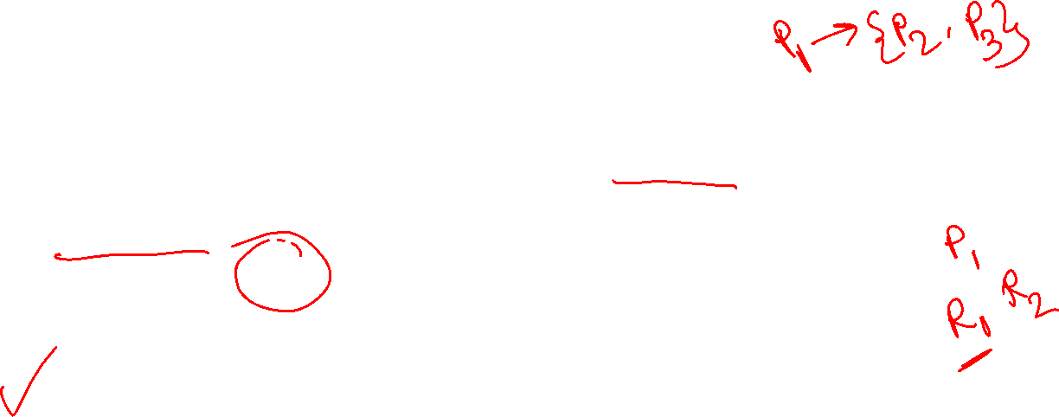
OR Model
a process can make a request for multiple resources simultaneously
request is satisfied if any one of the requested resources is granted
requested resources may exist at different locations
if all requests in the WFG are OR requests, then the nodes are called OR nodes
presence of a knot indicates a deadlock
with every blocked process, there is an associated set of processes called dependent set
a blocked process becomes active on receiving a grant message from any one of the processes in its dependent set
a process is permanently blocked if it never receives a grant message from any of the processes in its dependent set

Slide 12
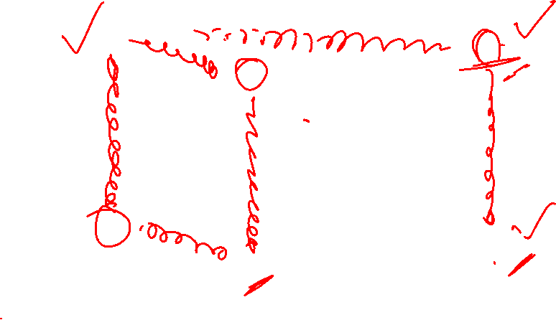
OR Model

Slide 13
OR Model
deadlock detection in the OR model is equivalent to finding knots in the graph
note: there can be a deadlocked process that is not a part of a knot
in an OR model, a blocked process P is deadlocked if it is either in a knot or it can only reach processes on a knot

Slide 14

Chandy–Misra–Haas Algorithm for the AND model
uses a special message called probe
probe is a triplet (i, j, k)
denotes that
it belongs to a deadlock detection initiated for P_{i} (1st element)
it is sent by the home site of P_{j} (2nd element)
it is sent to the home site of P_{k} (3rd element)
probe message travels along the edges of the global WFG graph
deadlock is detected when a probe message returns to the process that initiated it

Slide 15
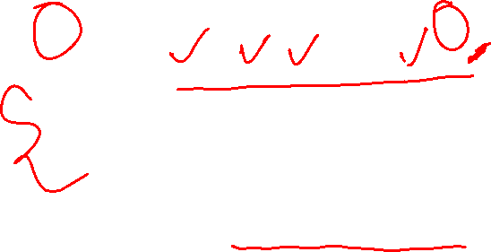
Chandy–Misra–Haas Algorithm for the AND model
P_{j} is said to be dependent on P_{k} if there exists a sequence of processes P_{j}, P_{i1}, P_{i2}, . . . , P_{im}, P_{k} such that
each process except P_{k} in the sequence is blocked
each process, except P_{j}, holds a resource for which the previous process in the sequence is waiting
P_{j} is said to be locally dependent upon P_{k} if
P_{j} is dependent upon P_{k}
both the processes are on the same site

Slide 16
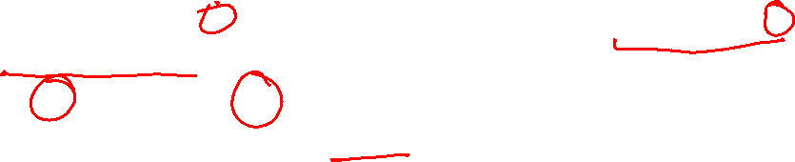
Chandy–Misra–Haas Algorithm for the AND model
Data structures
each process P_{i} maintains a boolean array, dependent_{i}
dependent_{i}(j) is true if
P_{i} knows that P_{j} is dependent on it
initially, dependent_{i}(j) is false for all i and j

Slide 17
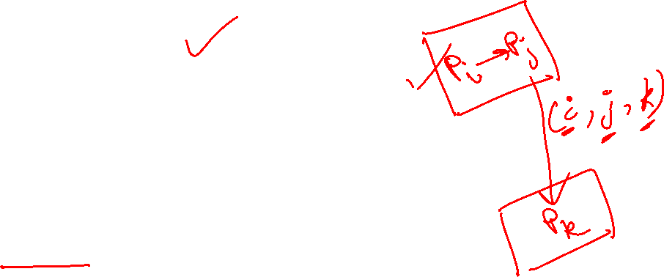

Chandy–Misra–Haas Algorithm for the AND model
if P_{i} is locally dependent on itself
then declare a deadlock
else for all P_{j} and P_{k} such that
(a) P_{i} is locally dependent upon P_{j} , and
(b) P_{j} is waiting on P_{k}, and
(c) P_{j} and P_{k} are on different sites,
send a probe (i, j, k) to the home site of P_{k}

Slide 18
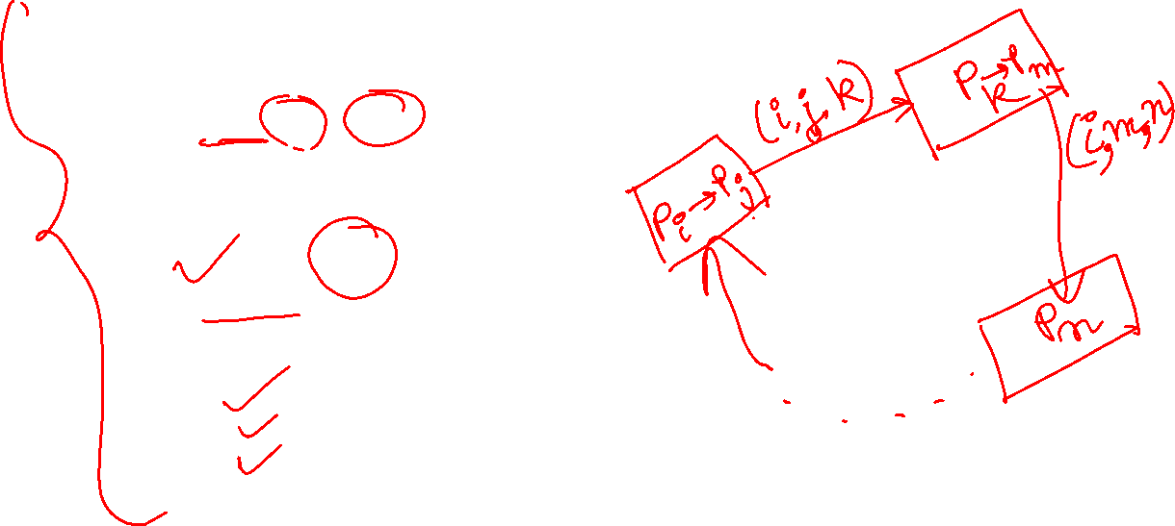
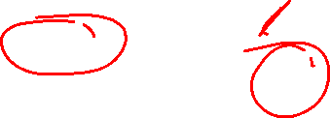
Chandy–Misra–Haas Algorithm for the AND model
On receipt of a probe (i, j, k), the site takes the following actions:
if
(d) P_{k} is blocked, and
(e) dependent_{k}(i) is false, and
(f) P_{k} has not replied to all requests by P_{j},
then
begin
dependent_{k}(i) = true;
if k = i
then declare that P_{i} is deadlocked
else for all P_{m} and P_{n} such that
(a’) P_{k} is locally dependent upon P_{m}, and
(b’) P_{m} is waiting on P_{n}, and
(c’) P_{m} and P_{n} are on different sites,
send a probe (i, m, n) to the home site of P_{n}
end

Slide 19
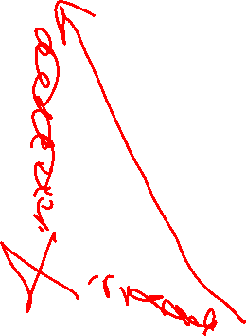
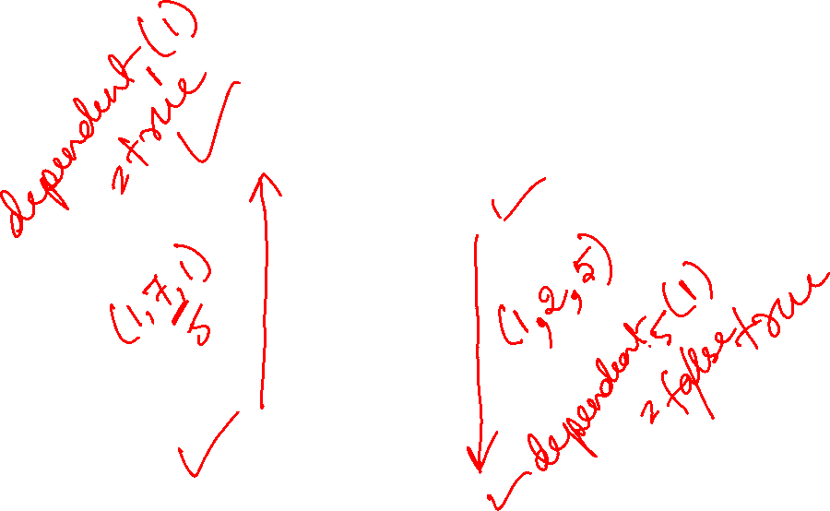
Chandy–Misra–Haas Algorithm for the AND model

Slide 20
Chandy–Misra–Haas Algorithm for the AND model
Performance analysis
algorithm exchanges at most m(n−1)/2 messages to detect a deadlock that involves m processes and spans over n sites

Slide 21

Chandy–Misra–Haas Algorithm for the OR model
2 types of messages are used:
query(i, j, k)
reply(i, j, k)
denote that they belong to a diffusion computation initiated by P_{i} and are being sent from P_{j} to P_{k}
a blocked process initiates deadlock detection by sending query messages to all processes in its dependent set (i.e., processes from which it is waiting to receive a message)

Slide 22
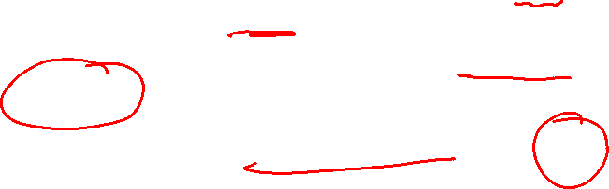

Chandy–Misra–Haas Algorithm for the OR model
local variable num_{k}(i) = number of query messages sent
P_{k} maintains a boolean variable wait_{k}(i)
wait_{k}(i) denotes that P_{k} has been continuously blocked since it received the last engaging query from P_{i}

Slide 23
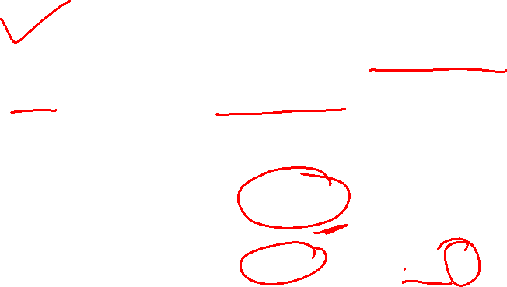
Chandy–Misra–Haas Algorithm for the OR model
first query message received by P_{k} for the deadlock detection initiated by P_{i} → engaging query
if an active process receives a query or reply message, it discards it
when a blocked process P_{k} receives a query(i, j, k) message, it takes certain actions
if this is the engaging query from P_{i}, P_{k} propagates the query to all the processes in its dependent set and sets num_{k}(i) = number of query messages sent
if this is not engaging query, P_{k} returns a reply message if P_{k} has been continuously blocked since it received the corresponding engaging query
if P_{k} is not blocked, it discards the query

Slide 24
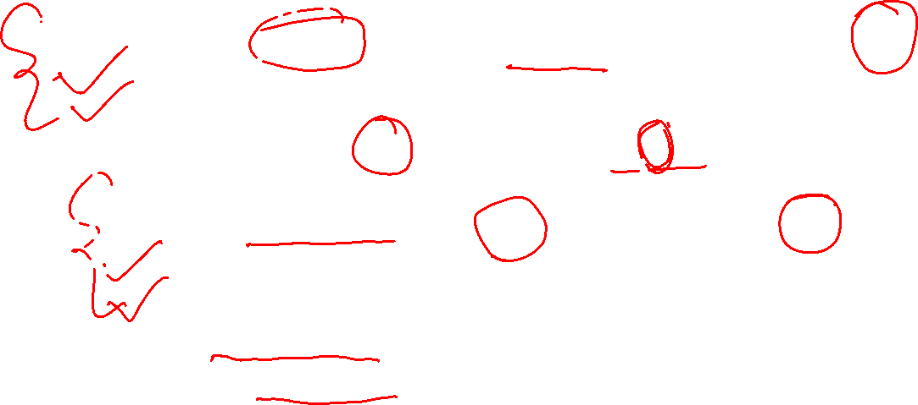
Chandy–Misra–Haas Algorithm for the OR model
Initiate a deadlock detection for a blocked process P_{i}:
send query(i, i, j) to all processes P_{j} in the dependent set DS_{i} of P_{i}
num_{i}(i) = |DS_{i}|
wait_{i}(i) = true
When a blocked process P_{k} receives a query(i, j, k):
if this is the engaging query for process P_{i} then
send query(i, k, m) to all P_{m} in its dependent set DS_{k}
num_{k}(i) = |DS_{k}|
wait_{k}(i) = true
else if wait_{k}(i) = true then
send a reply(i, k, j) to P_{j}

Slide 25

Chandy–Misra–Haas Algorithm for the OR model
When a process P_{k} receives a reply(i, j, k):
if wait_{k}(i) = true then
num_{k}(i) = num_{k}(i) − 1
if num_{k}(i) = 0 then
if i = k then declare a deadlock
else send reply(i, k, m) to the process P_{m} which sent
the engaging query

Slide 26
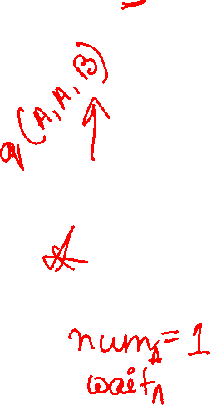
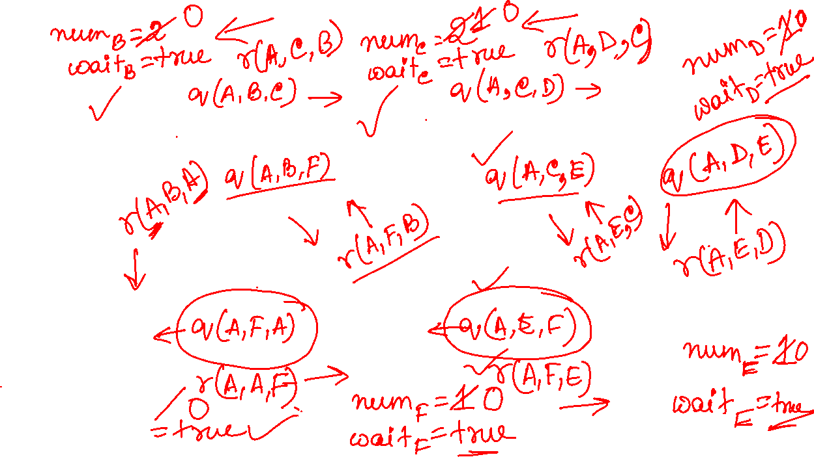
Chandy–Misra–Haas Algorithm for the OR model
B
C
D
A
F
E

Slide 27
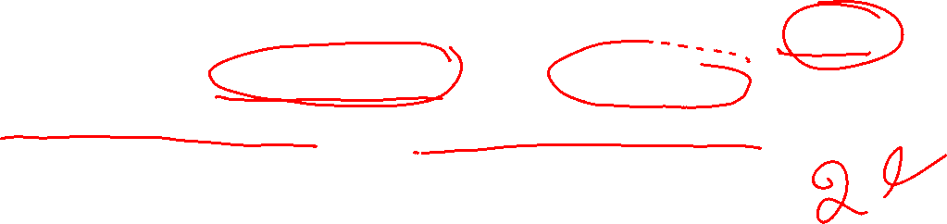
Chandy–Misra–Haas Algorithm for the OR model
Performance analysis
for every deadlock detection, the algorithm exchanges e query messages and e reply messages, where e = n(n − 1)
e is the number of edges, n is the number of processes

Slide 28
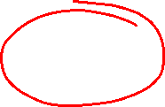
Deadlock Resolution
deadlock resolution involves breaking existing wait-for dependencies between processes
rolling back one or more deadlocked processes
assigning resources of rolled back processes to blocked processes
blocked processes resume execution
when a wait-for dependency is broken
the corresponding information should be immediately cleaned from the system
otherwise may result in detection of phantom deadlocks

Slide 29
References
Ajay D. Kshemkalyani, and Mukesh Singhal, Chapter 10, “Distributed Computing: Principles, Algorithms, and Systems”, Cambridge University Press, 2008.
http://greenteapress.com/complexity/html/thinkcomplexity014.html
ube.ege.edu.tr/~cinsdiki/2006...8.../Chandy-Misra-Haas-DistDeadlockDetection.ppt

Slide 30
Thank You

